Slide 1
HPC for Analysis of Biological Data
Dr. Yogita
Department of Computer Science and Engineering
NIT Meghalaya

Slide 2
Three Critical Molecule in Reference of Biological Data
Three Critical Molecule :-
Protein
Deoxyribonucleic Acid [DNA]
Ribonucleic Acid [RNA]

Slide 3
Types of Biological Data
Type of Biological Data
Nucleotide Sequences
Protein Sequences
Proteins Sequence Patterns or Motifs
Proteins 3D Structure
Gene Expression Data
Metabolic Pathways
PPI
PDI
PMI

Slide 4
Application of Biological Data Analysis
Biomarker Identification
Drug Discovery
Forensic Science
Understanding Biological Processes
Precision and Preventive Medicines
Evolutionary studies.
Plant Modelling

Slide 5
Challenges in Processing Biological Data
High Dimensionality
Small Sample Size for Different Conditions
Different Experimental Conditions
Multi Label Behavior
Large Volume

Slide 6
Aspect of Biological Data Processing in Reference of HPC
There are two aspect of biological data processing in reference of HPC
To extract the gene triplets and create their gene interaction network
DL models for cancer prediction

Slide 7
Motivation
Advances in microarray technology, have made availability of gene expression data easier as they can capture mRNA expression for thousands of genes parallelly. This has further pushed the needs for appropriate computational techniques for gene expression data analysis.
Cancer can develop in any part of the body where cell growth becomes abnormally unregulated and cells proliferate in an uncontrolled manner, invading nearby normal tissues. Cancer as a disease that is less understood so we have taken up this disease dataset for analysis.
Drug discovery for cancer treatment and early detection of cancer in patients are two important areas where computational techniques can aid and speedup wet lab efforts.

Slide 8
Research Issue Addressed
Most of the work on gene expression data has been done for finding gene pairs which represent either activator or repressor relationship. Very few work has been done towards detection of gene triplets. So there is a scope for developing computational techniques for finding gene triplets.
In case of gene triplets, most of the work has been done over lower organism datasets but to the best of our knowledge no work has been reported towards detection of gene triplets from mammalian expression data. So there is a scope for working in this direction.

Slide 9
Preliminary Concepts
Gene Interaction Network (GIN) is a set of genes (nodes) connected by edges representing functional relationships among these genes. Relationships is in the form of physical interaction through their gene products, e.g., proteins, or one of the genes alters or affects the activity of other gene of interest [2] [3] .

Slide 10
Preliminary Concepts
An interaction between two genes is represented as G_{A} G_{T} where G_{A} is gene A and G_{T} is target gene T.
-The interaction could be activating, where activator gene G_{A} activates.
-The interaction could be repressing, where repressor gene G_{A} represses G_{T}.
A gene triplet is a group of three genes with a repressor-target-activator relationship. It is represented as
G_{A} G_{T} G_{R}.
 | gene1 | gene2 | …. | gene100
Sample1 | 0.03 | 0.2 | … | 0.67
Sample2 | 0.003 | 0.09 | … | 1.2
…. | 0.3 | 0.5 | … | 0.9
Sample3 | 0.56 | 1.2 | … | 1.99
Table 1: Gene expression dataset representation

Slide 11
Methodology
The methodology adapted for this project work includes the following steps. It is followed by experimental setup and tools used to accomplish the project tasks.
Experimental Setup and Tools
Python 3.7.0 was used for data preprocessing and result analysis and visualization.
RSES 2.2.2 Tool was used for identiﬁcation of key genes from gene expression dataset using Rough Set Theory.
Fuzzy Toolbox from MATLAB 2017a was used for designing Fuzzy Inference System for triplet generation.
Figure 3: Methodology flowchart

Slide 12
Methodology:
Dataset Used
Disease: | Lung Adenocarcinoma
GEO Accession No. : | GSE10072
No. of genes (columns): | 22283
No. of samples (rows): | 107
No. of Tumor Samples: | 58
No. of Non-Tumor Samples: | 49
Microarray Technology: | HG-U133A
Table 2: Dataset used

Slide 13
Methodology: Dimensionality Reduction
Dimensionality Reduction using Rough Set Theory (RST)
For extracting key genes from gene expression dataset using RST the following steps were undertaken:
Reduct Generation
Given a decision system, Rough Sets work by generating reducts which are a minimal set of attributes from the entire set of attributes which maintains the dependency of decision attributes on conditional attributes.

Slide 14
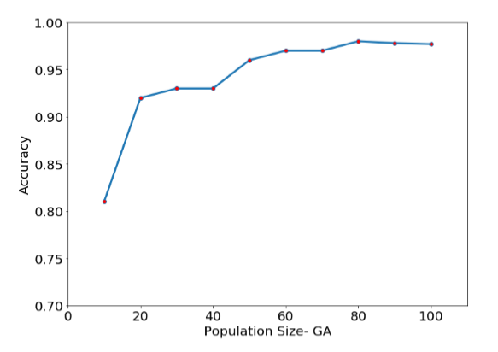
Reduct Calculation using Genetic Algorithm
Application of RST for Key Genes extraction from dataset
RSES 2.2.2 Tool has been used to apply RST for extracting the key genes.
Genetic Algorithm was used for finding reducts and the following graph shows population size which is a GA parameter w.r.t accuracy and this was used to find optimal population size.
Figure 4: optimal population size for GA based reduct calculation.

Slide 15
Reduct Generation
No. | Sample Reduct Set
1. | FIG4, ASGR1, MECOM, LAIR2, HTN3, TNFRSF1A, NEBL, TGFBR2, GPR35, RPS4X
2. | FIG4, ASGR1, MECOM, LAIR2, HTN3, TNFRSF1A, RFC3, SPOP, PON1, MRAS
3. | POLR2B, KLF9, KCNJ10, STK10, GRIN2D, MID1, NAT2
4. | POLR2B, KLF9, KCNJ10, STK10, GRIN2D, RFC3, CALD1, FBLN1, DLAT
5. | HIST2H2BE, SPAG5, KRR1, PCSK5, NREP, C4orf46, NLRP1
6. | HIST2H2BE, SPAG5, KRR1, PCSK5, C4orf46, RYBP, CD80, RRS1
7. | LAPTM4A, DNAJB12, ABCA1, TGFBR2, BCLAF1, MRAS, GATA2
8. | LAPTM4A, DNAJB12, ABCA1, TGFBR2
9. | LAPTM4A, DNAJB12, ABCA1, SMC2, C1S, GATA2
10. | LAPTM4A, DNAJB12, BCLAF1, TMED1, FRZB, MTERF1, MRAS, TGFBR2, DUT, TRIB3
11. | KLF9, IGF1, TRADD, HLA-DPB1, CCL20, PSMG2
12. | BHLHE40, ADK, RCAN1, LMBRD1, HSPA9, METAP2, ARVCF
Table 4: Sample Reduct Set

Slide 16
Methodology: Fuzzy Inference System
Design of Fuzzy Inference System
Fuzzy Rule Set
Expert knowledge based heuristic fuzzy rules must be designed which will be used as if-then rules along with known facts to derive conclusions.
Triplets of genes has been considered Activator gene (G_{A}) enhances, Target (G_{T} ) and Repressor Gene G_{R} represses Target (G_{T} ).
Triangular Membership function with Lo, Med and Hi MFs has been used.
G_{A}\G_{R} | High | Medium | Low
High | G_{T} is Medium | G_{T} is High | G_{T} is High
Medium | G_{T} is Low | G_{T} is Medium | G_{T} is High
Low | G_{T} is Low | G_{T} is Low | G_{T} is Medium
Figure 5: FIS
Table 6: Fuzzy Rules

Slide 17
Methodology: Fuzzy Inference System
Workflow of a Fuzzy Inference System:
Membership Function (triangular MF) for fuzzification
Mamdani
Fuzzy Inference System
Numeric input data
Defuzzify predicted output
Fuzzified input data
A\B | High | Medium | Low
High | C is Medium | C is High | C is High
Medium | C is Low | C is Medium | C is High
Low | C is Low | C is Low | C is Medium
Fuzzy Rules
Figure 6: FIS Workflow

Slide 18
Methodology: Triplet Generation and Pruning
Preprocessing of dataset
Extract data for only the key-genes extracted in above step from original dataset.
Divide data into Tumor and Normal data based on the decision attribute in order to do a comparative study of gene networks in tumor and non-tumor condition.
Normalize data to 0-1 range to feed to FIS system.
Triplet Generation and Prediction of Target Gene expression Data using Fuzzy Logic
Generate ⁵³P₃ combinations of activator-repressor-target triplets.
Predict gene expression data for the target gene using fuzzy inference system.
Prune out irrelevant triplets using root mean square error between observed and predicted target gene’s expression data.

Slide 19
Triplets from Tumor Data
No. | Triplet | RMSE Score
1. | FRMD4A-SNRK-MRPL41 | 0.0397
2. | FRMD4A-MRPL41-KAT6A | 0.0219
3. | PRMT2-PTP4A2-CADM1 | 0.0974
4. | MEIS1-KAT6A-PTPRD | 0.1094
5. | FRMD4A-PTPRD-PTP4A2 | 0.1108
6. | FGR-KAT6A-PTPRD | 0.1138
Table 7: Sample Triplets

Slide 20
Triplets from Non Tumor Data
No. | Triplet | RMSE Score
1. | PRRC2C-CADM1-FRMD4A | 0.134
2. | PRMT2-ID4-SEMA5A | 0.153
3. | ATOH1-MEIS1-SERPINA1 | 0.104
4. | SEMA5A-MEIS1-SERPINA1 | 0.103
5. | PTPRD-MEIS1-SERPINA1 | .096
6. | PTPRD-PTP4A2-PRMT2 | 0.075
Table 8:Sample Triplets

Slide 21
Validation
Validation
Validation of gene interactions was done using existing literature, Gene Cards and NCBI Gene databases [19].
Real gene interactions corresponding to 53 key genes have been generated using the genemania.org site [5].
Using the top triplets, two separate networks, representing normal lung condition and lung tumor condition has been constructed using Python NetworkX library.

Slide 22
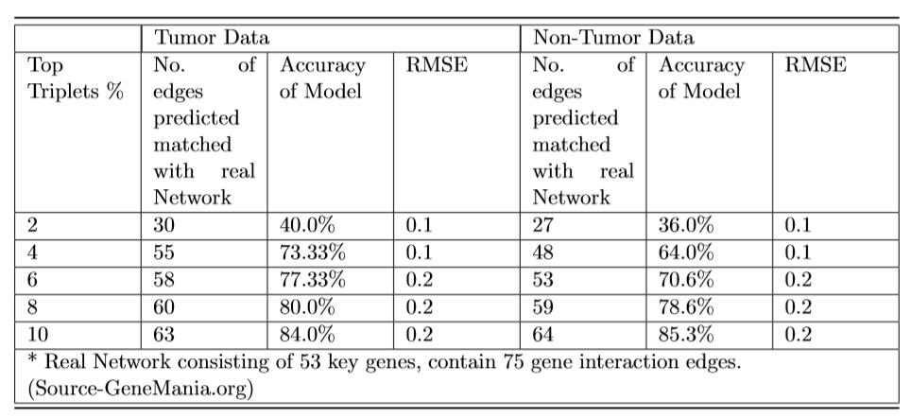
Results: Fuzzy Inference Model Accuracy
Table 9: Accuracy of Fuzzy Logic Model in predicting gene interaction edges on tumor and Non-Tumor dataset

Slide 23
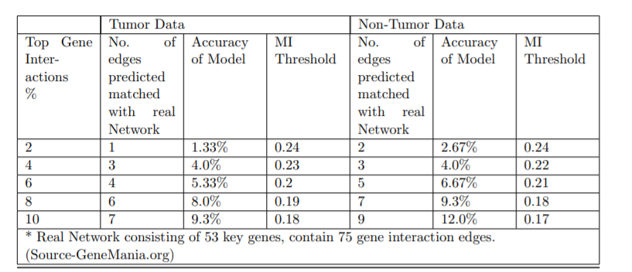
Results: Comparative study of FIS with Mutual Information based Model
Table 10: Accuracy of Mutual Information Model in predicting gene interaction edges on tumor and Non-Tumor dataset

Slide 24
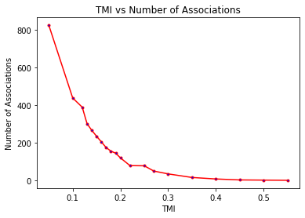
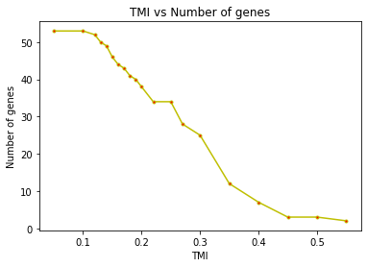
Results: Comparative Study of FIS with Mutual Information based Model
a) No. of edges vs MI threshold
b) No. of genes vs MI Threshold
Figure 7: Mutual Information threshold analysis

Slide 25
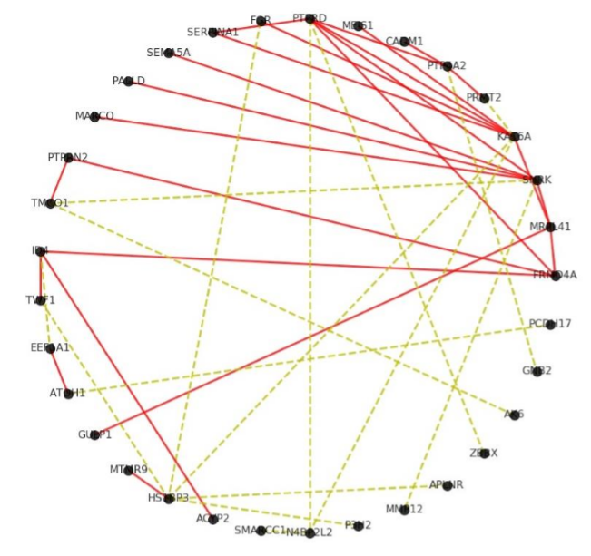
Results: Visualization of Gene Interaction Network (Tumor Data)
The red-colored edges show the interaction that were observed using proposed model and validated subsequently.
The yellow dashed edges show the edges that were found but whose existence could not be veriﬁed using existing literature.
However, these edges can hint at novel interactions only present in tumorous conditions and need further exploration
Figure 8: G1- Network Inferred using Tumor Data

Slide 26
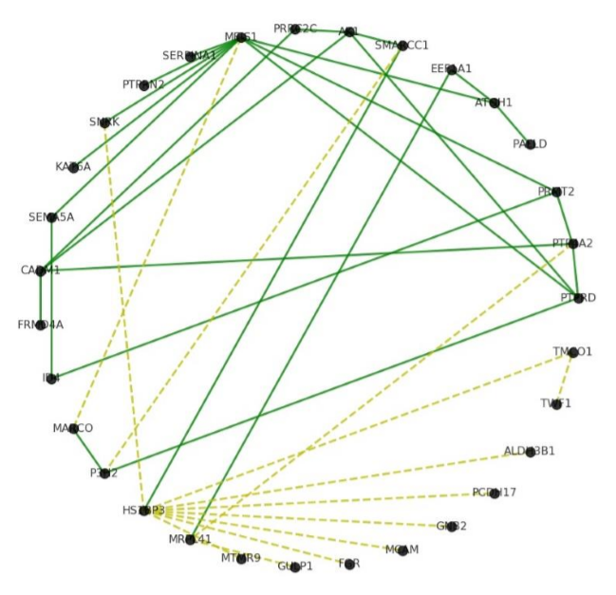
Results: Visualization of Gene Interaction Network (Non Tumor Data)
The green colored edges show the interaction that were observed in non-tumor using proposed model and validated subsequently.
The yellow dashed edges show the edges that were found but whose existence could not be veriﬁed using existing literature.
Figure 9: G2- Network Inferred using Non-Tumor Data

Slide 27
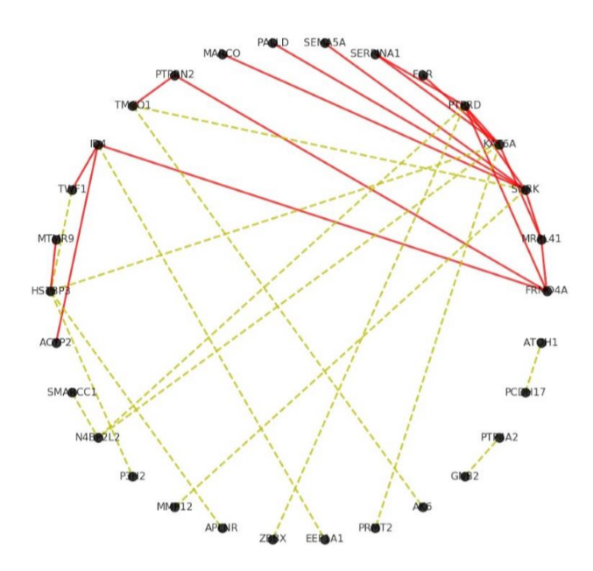
Results: Visualization of Gene Interaction Network
(Unique Edges in Tumor Data)
The red-colored edges show the interaction that were uniquely observed using proposed model in tumor data only.
The yellow dashed edges show the edges that were found but whose existence could not be veriﬁed using existing literature.
Figure 10: G3- Network Inferred using Non-Tumor Data

Slide 28
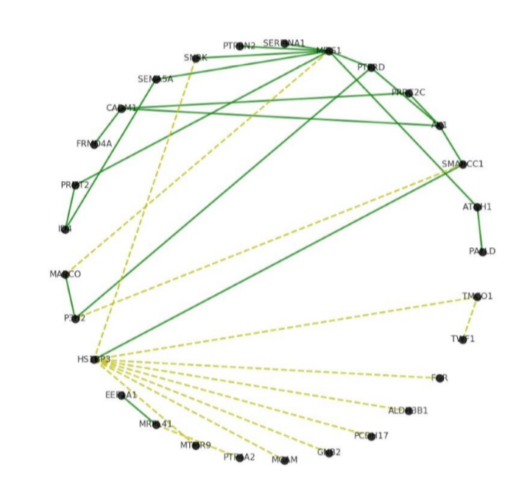
Results: Visualization of Gene Interaction Network
(Unique Edges in Non- Tumor Data)
The green-colored edges show the interaction that were uniquely observed using proposed model in Non- tumor data only.
The yellow dashed edges show the edges that were found but whose existence could not be veriﬁed using existing literature.
Figure 11: G4- Network Inferred using Non-Tumor Data

Slide 29
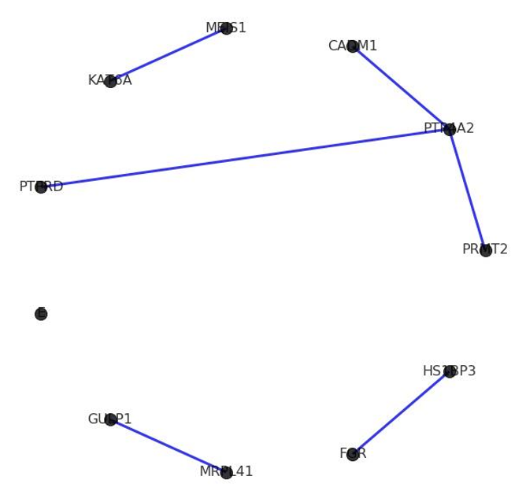
Results: Visualization of Gene Interaction Network (Common Edges)
G5 represents the common edges found in both the networks.
Figure 12: G5- Network of common edges found in both datasets

Slide 30
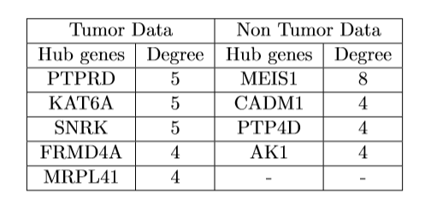
Results: Hub Genes
Table: 11- Hub Genes extracted
Hub genes are biologically signiﬁcant genes as they provide scope for new drug targets as they are able to control many more genes, thus aiding in drug eﬃcacy.

Slide 31
Discussion
Significance of triplets extracted in tumor data
FRMD4A and MRPL41 both have role in protein formation through translation and thus are positively related. MRPL41 has been known to have involved in cell apoptosis which is the controlled growth of cells while SNRK is involved in hematopoietic cell proliferation, thus the relation that exists between the two is negative.
FRMD4A
SNRK
MRPL41
Figure 13: Triplet from tumor data

Slide 32
Discussion
Significance of triplets extracted in non-tumor data
Both PTPRD and PTP4A2 involved in protein dephosphorylation. PRMT2 has been known to negatively regulated transcription while PTP4A2 is actively involved in posttranslational protein modiﬁcation. So a negative interactional relationship can be found between the two genes in protein formation.
PTPRD
PRMT2
PTP4A2
Figure 14: Triplet from non-tumor data

Slide 33
Analysis of
performance of deep learning models for binary classification of cancer gene expression data
Train
Deep Model
Tumor
Test
Normal
Representative image

Slide 34
Methodology
Figure 15: Methodology Flowchart
Table 12: Datasets Used

Slide 35
Methodology
Feature Selection Methods used:
ANOVA or Analysis of Variance: works by ﬁnding those genes which have the strongest relevance or association with the target variable where V is the relevance score of gene i with class label h, F the F-score which we deﬁne below, S is the set of all genes.
Information Gain: it examines each attribute individually and measure the amount of information gain which measures the decrease in entropy of class label Y given an attribute X which basically signiﬁes the attribute’s importance and relevance to the class label.a

Slide 36
Results: Dimensionality Reduction of Datasets
Table 13: Dimensionality Reduction of Datasets

Slide 37
Results: Parameter Tuning (MLP)
Table 14: Parameter Tuning for MLP

Slide 38
Results: Parameter Tuning (1DCNN)
Table 15: Parameter Tuning for 1DCNN

Slide 39
Results: Parameter Tuning (2DCNN)
Table 16: Parameter Tuning for 2DCNN

Slide 40
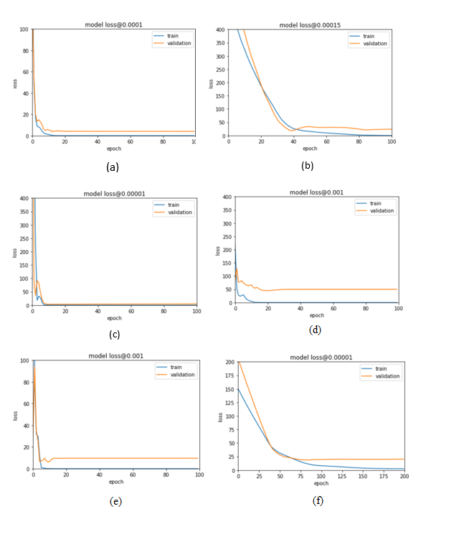
Results: Hyper-Parameter Setting (Colon Cancer Dataset)
Figure 17 : Hyperparameter Setting for Colon Cancer dataset Clockwise from top:a-MLP(ANOVA) b-MLP(Entropy) c-1DCNN(ANOVA) d-1DCNN(Entropy) e-2DCNN(ANOVA) f-2DCNN(Entropy

Slide 41
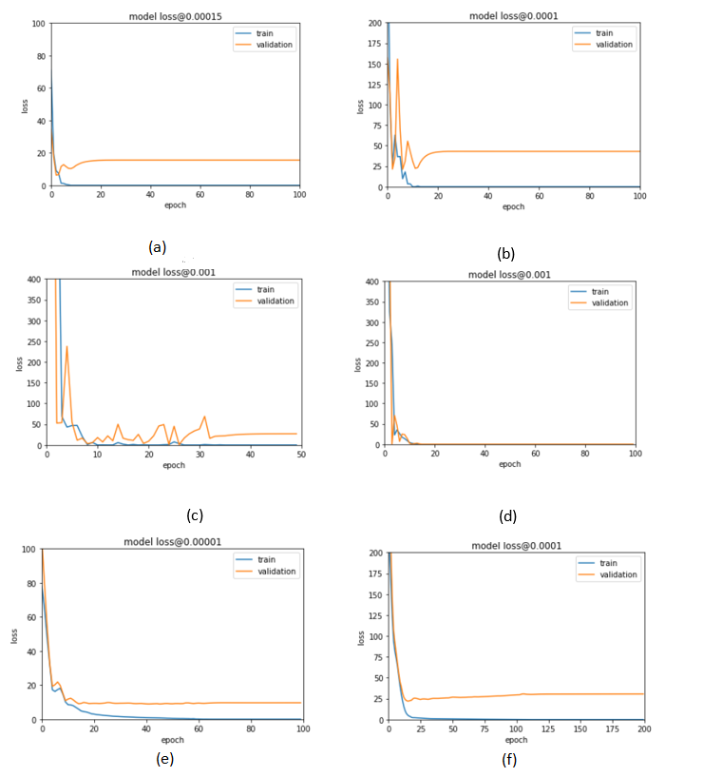
Results: Hyper-Parameter Setting (Pancreatic Cancer Dataset)
Figure 18: Hyperparameter Setting for Pancreatic Cancer dataset Clockwise from top:a-MLP(ANOVA) b-MLP(Entropy) c-1DCNN(ANOVA) d-1DCNN(Entropy) e-2DCNN(ANOVA) f-2DCNN(Entropy)

Slide 42
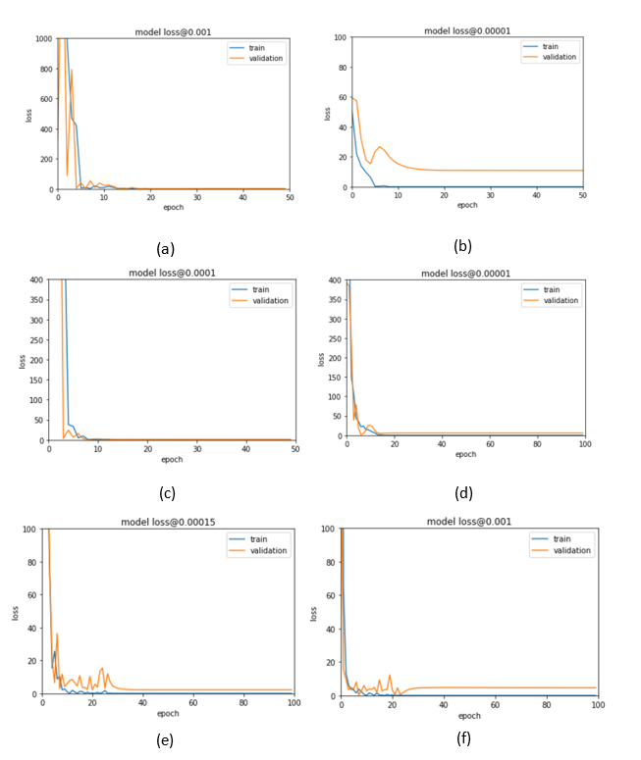
Results: Hyper-Parameter Setting (Breast Cancer Dataset)
Figure 19: Hyperparameter Setting for Breast Cancer dataset Clockwise from top:a-MLP(ANOVA) b-MLP(Entropy) c-1DCNN(ANOVA) d1DCNN(Entropy) e-2DCNN(ANOVA) f-2DCNN(Entropy)

Slide 43
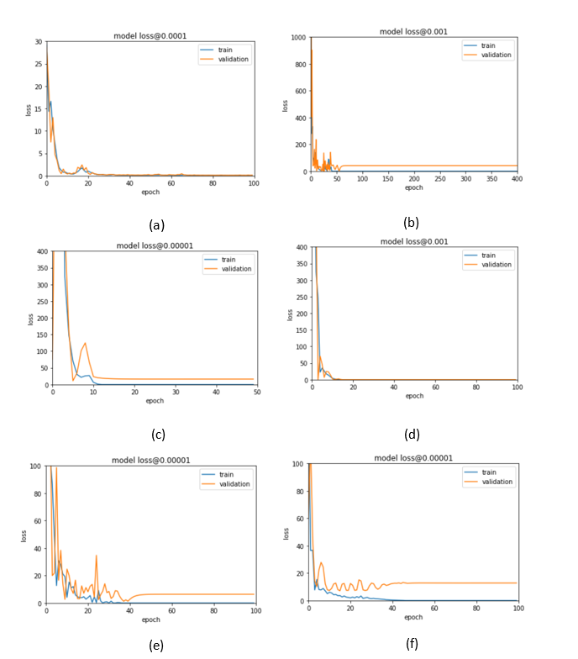
Results: Hyper-Parameter Setting (Lung Cancer Dataset)
Figure 20: Hyperparameter Setting for Lung Cancer dataset. Clockwise from top, aMLP(ANOVA) b-MLP(Entropy) c-1DCNN(ANOVA) d-1DCNN(Entropy) e-2DCNN(ANOVA) f-2DCNN(Entropy)

Slide 44
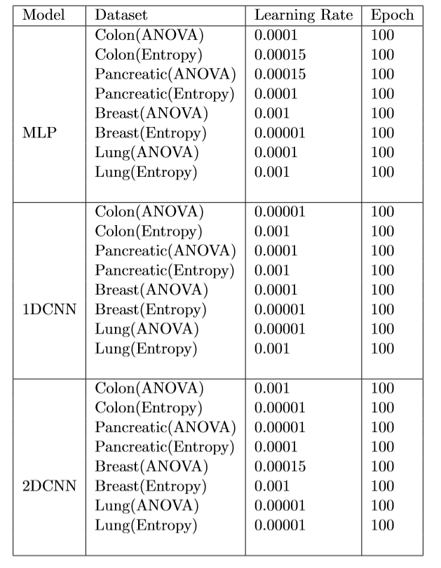
Results: Hyper-Parameter Tuning
Table 17: Hyper-Parameter Tuning

Slide 45
Results: MLP Model Evaluation
Table 18: Evaluation metrics for MLP

Slide 46
Results: MLP Model Evaluation
Table 19: Evaluation metrics for 1DCNN

Slide 47
Results: MLP Model Evaluation
Table 20: Evaluation metrics for 2DCNN

Slide 48
Conclusion
HPC is an integral part of Biological Data Analysis

Slide 49
References
Kwon, M. S., Park, M., & Park, T. (2014). IGENT: efficient entropy based algorithm for genome-wide gene-gene interaction analysis. BMC medical genomics, 7(1), S6.
G. Bebek, “Identifying gene interaction networks,” in Statistical Human Genetics, pp. 483– 494, Springer, 2012.
M. Hecker, S. Lambeck, S. Toepfer, E. Van Someren, and R. Guthke, “Gene regulatory network inference: data integration in dynamic models—a review,” Biosystems, vol. 96, no. 1, pp. 86–103, 2009.
G. Stelzer, N. Rosen, I. Plaschkes, S. Zimmerman, M. Twik, S. Fishilevich, T. I. Stein, R. Nudel, I. Lieder, Y. Mazor, et al., “The genecards suite: from gene data mining to disease genome sequence analyses,” Current protocols in bioinformatics, vol. 54, no. 1,pp. 1–30, 2016.
“genemania.org.” https://genemania.org/. Accessed: 2019-12.
M. Mostavi, Y.-C. Chiu, Y. Huang, and Y. Chen, “Convolutional neural network models for cancer type prediction based on gene expression,” arXiv preprint arXiv:1906.07794, 2019.

Slide 50
References
N. Noman and H. Iba, “Reverse engineering genetic networks using evolutionary computation, Genome
informatics, vol. 16, no. 2, pp. 205–214, 2005.’
8. T. Chen, V. Filkov, and S. S. Skiena, “Identifying gene regulatory networks from experimental data,”
Parallel computing, vol. 27, no. 1-2, pp. 141–162, 2001.
S. Liang, S. Fuhrman, and R. Somogyi, “Reveal, a general reverse engineering algorithm for inference of genetic network architectures,” 1998.
10. M. Zou and S. D. Conzen, “A new dynamic bayesian network (dbn) approach for identifying gene
regulatory networks from time course microarray data,” Bioinformatics, vol. 21, no. 1,pp. 71–79,
2005.
P. J. Woolf and Y. Wang, “A fuzzy logic approach to analyzing gene expression data,” Physiological
Genomics, vol. 3, no. 1, pp. 9–15, 2000.
12. P. Du, J. Gong, E. S. Wurtele, and J. A. Dickerson, “Modeling gene expression networks using fuzzy
logic,” IEEE Transactions on Systems, Man, and Cybernetics, Part B (Cybernetics), vol. 35, no. 6,
pp.
1351–1359, 2005.

Slide 51
References
S. Vineetha, C. C. S. Bhat, and S. M. Idicula, “Gene regulatory network from microarray data of colon cancer patients using tsk-type recurrent neural fuzzy network,” Gene, vol. 506, no. 2, pp. 408–416, 2012.
14. S. Mandal, G. Saha, and R. K. Pal, “Neural network based gene regulatory network reconstruction,” in Proceedings of the 2015 Third International Conference on Computer, Communication, Control and Information Technology (C3IT), pp. 1–5, IEEE, 2015.
15. A. A. Margolin, I. Nemenman, K. Basso, C. Wiggins, G. Stolovitzky, R. Dalla Favera, and A. Califano, “Aracne: an algorithm for the reconstruction of gene regulatory networks in a mammalian cellular context,” in BMC bioinformatics, vol. 7, p. S7, Springer, 2006.
F. Chu, W. Xie, and L. Wang, “Gene selection and cancer classiﬁcation using a fuzzy neural network,” in IEEE AnnuaMeeting of the Fuzzy Information, 2004. Processing NAFIPS’04., vol. 2, pp. 555–559, IEEE, 2004.
S. B. Cho and H.-H. Won, “Cancer classiﬁcation using ensemble of neural networks with multiple signiﬁcant gene subsets,” Applied Intelligence, vol. 26, no. 3, pp. 243–250, 2007.
18. S. Agrawal and J. Agrawal, “Neural network techniques for cancer prediction: A survey,” Procedia Computer Science, vol. 60, pp. 769–774, 2015.

Slide 52
References
19. P. Danaee, R. Ghaeini, and D. A. Hendrix, “A deep learning approach for cancer detection and relevant gene identiﬁcation,” in PACIFIC SYMPOSIUM ON BIOCOMPUTING 2017, pp. 219–229, World Scientiﬁc, 2017.
20. T. Ahn, T. Goo, C.-h. Lee, S. Kim, K. Han, S. Park, and T. Park, “Deep learning-based identiﬁcation of cancer normal tissue using gene expression data,” in 2018 IEEE International Conference on Bioinformatics and Biomedicine (BIBM), pp. 1748–1752, IEEE, 2018.
21. C. Li and M. Zhang, “Deep learning in pan-cancer early detection based on gene expression,” 2018.
M. Mostavi, Y.-C. Chiu, Y. Huang, and Y. Chen, “Convolutional neural network models for cancer type prediction based on gene expression,” arXiv preprint arXiv:1906.07794,2019.
R. R. Bhat, V. Viswanath, and X. Li, “Deepcancer: detecting cancer through gene expressions via deep generative learning,” arXiv preprint arXiv:1612.03211, 2016
A. Canakoglu, L. Nanni, A. Sokolovsky, and S. Ceri, “Designing and evaluating deep learning methods
for cancer classiﬁcation on gene expression data,” Proceedings of CIBB, vol. 2, p. 1, 2018.

Slide 53
The End
THANK YOU

